Slide 1
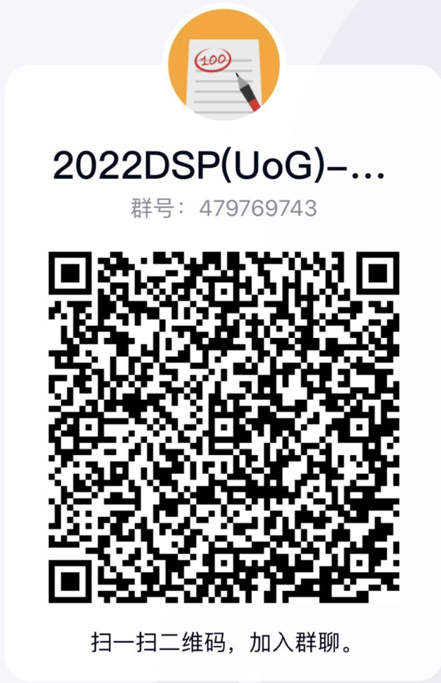
Digital Signal Processing
Lecturer ：杨鍊
科B250, Tel: 18981710751
Email：yanglian@uestc.edu.cn

Slide 2
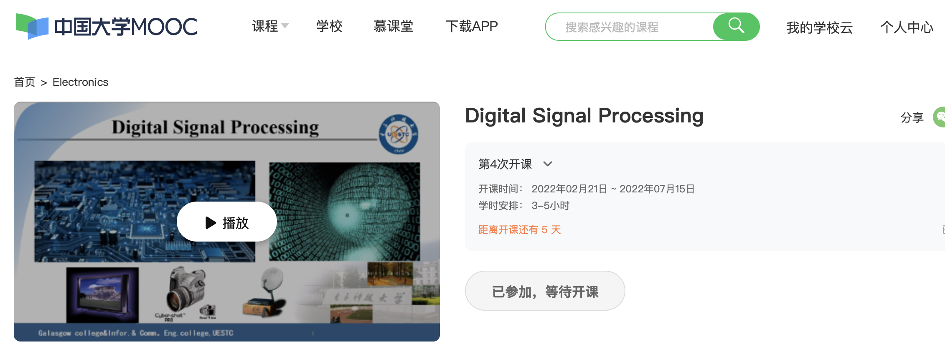
MOOC Website：
https://www.icourse163.org/course/UESTC1-1458252163

Slide 3
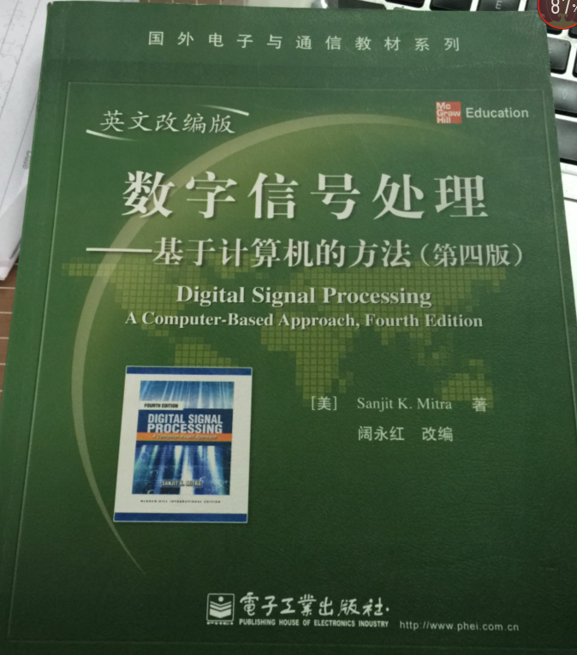
The Textbook
Digital Signal Processing----A Computer- Based Approach, Sanjit K.Mitra,4th Edition,McGraw-Hill,2014
电子工业出版社

Slide 4
Reference books
1. 奥本海姆（李玉柏等译），离散时间信号处理（原书第3版.精编版），机械工业出版社
2. 彭启琮等，数字信号处理,高等教育出版社
3. 彭启琮等,DSP与实时数字信号处理,电子科大出版社
4. 程佩青,数字信号处理教程,清华大学出版社
5.胡广书，数字信号处理——理论、算法与实现，清华大学出版社

Slide 5
Arrangement
1. Lectures，56 chs.（including course contents 48 chs. and presentations of course projects 8 chs.）
2. MOOC，about 32 chs.
3. Lab time，about 8 chs.
Mooc Login nickname：number_name

Slide 6
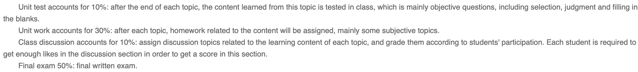
Grading
MOOC grade:10%
Course projects 20%
2. Course projects:15%
3. Mid-term exam(120 mins):35%
4. Final exam (120 mins):40%

Slide 7
Contents of Mooc
Mooc videos | Book chapters
Week1: DSP-introduction and MATLAB 2videos | Ch1
Week2: Digital Processing of Continuous Signals-2 | Ch2
Digital Processing of Continuous Signals-1&3 | Ch3.8
Digital Processing of Continuous Signals-4 | Ch12
Week3-4: DTFT 5videos | Ch3.1-3.6
Week5: Discrete Time System 4videos | Ch4
Week6-7: DFT 4videos&FFT 2video | Ch5&Ch11
Week8：ZT and IZT 5videos | Ch6
Week9-10:LTI Discrete-Time System in the Transform Domain 5videos | Ch7
Week11: Digital Filter Structures 2videos | Ch8
Week12-13: FDA tools&filter design 7videos | Ch9-10
Final Examination begins from Week 15.

Slide 8
Foreword
Characterization Of The Course
1.The Tech. Fields Used DSP:
Communication, Radio, Radar, Navigation, IT, etc
2. The Correlated Course:
Signals And Systems
Tech. Of DSP
Logic Circuit
DSP
Software Radio
Programm
VLSI,ASIC,……

Slide 9
Required Contents
§1
§2 2.1~2.5
§3* 3.1~3.9
§4 4.1~ 4.10
§5* 5.1~ 5.10
§6 6.1~6.7
§7 7.1~7.4
§8 8.1~8.6
§9 * 9.1~9.6
§10 * 10.1,10.2,10.5
§11 11.1~11.5
§A A.1~A.8

Slide 10
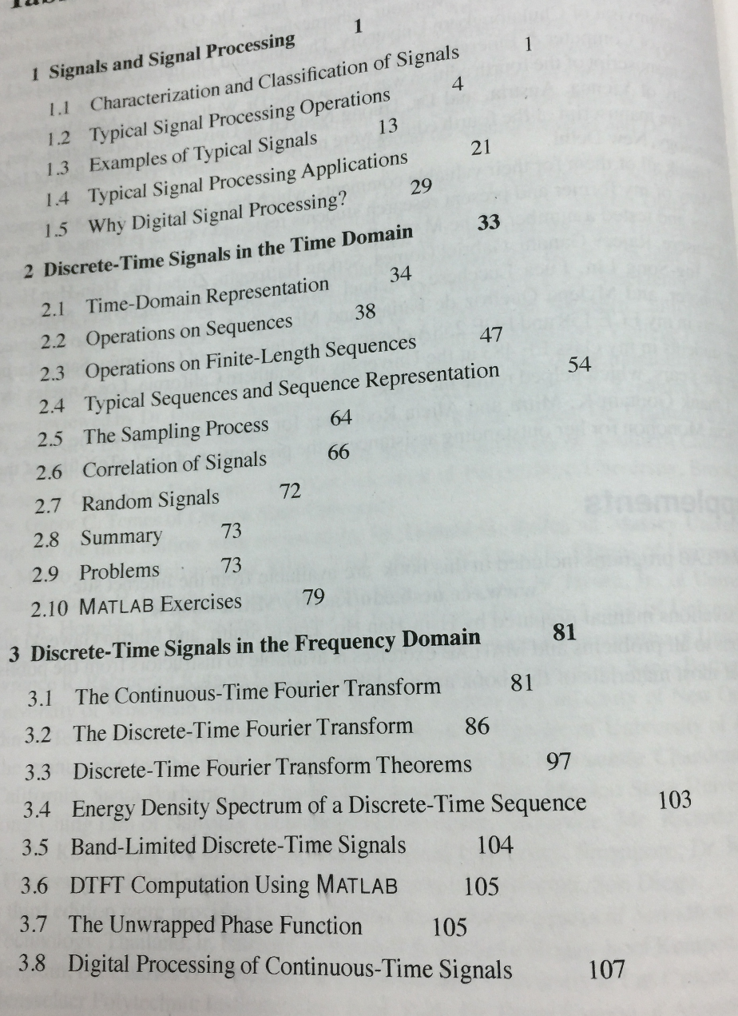
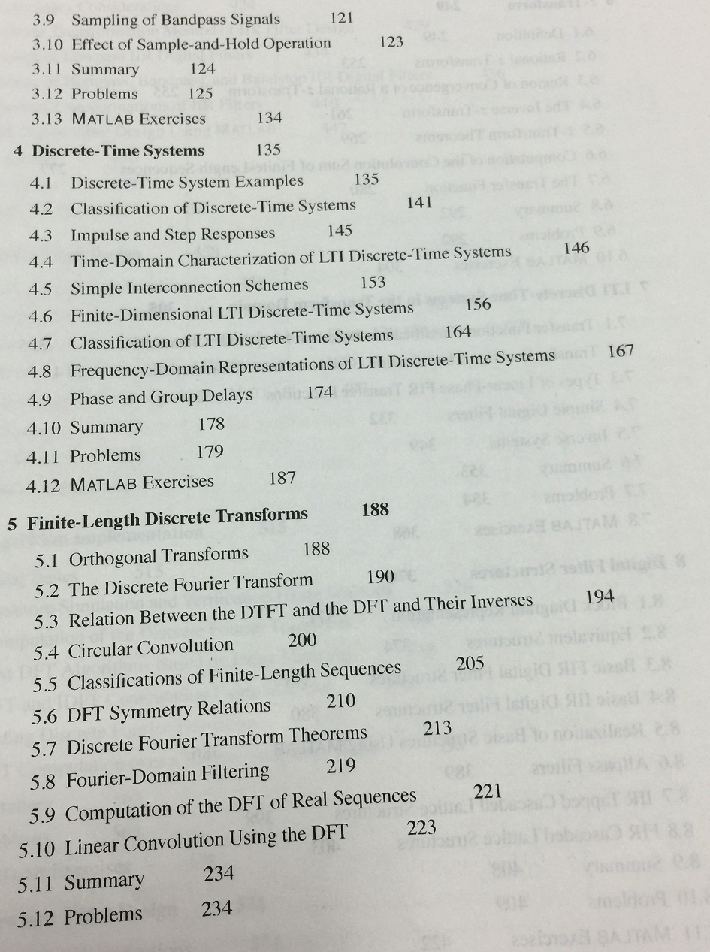

Slide 11
